Slide 1
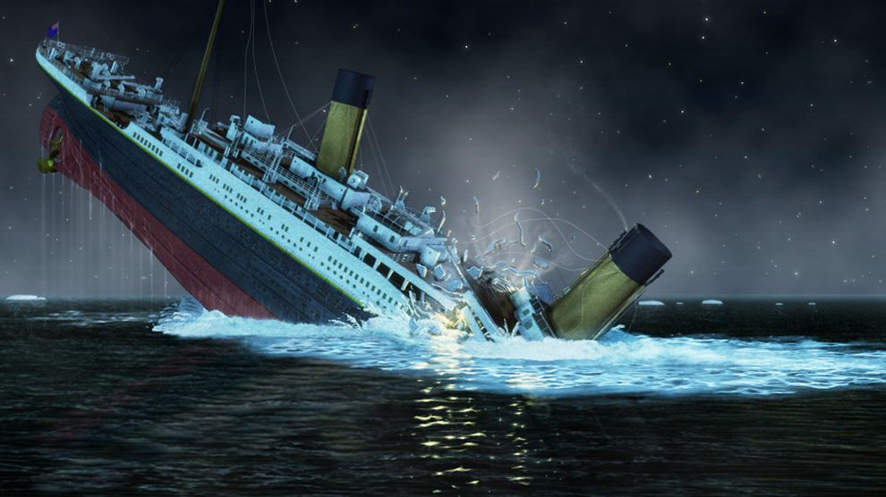
Titanic Project

Slide 2

Introduction -Competition Description
The sinking of the RMS Titanic is one of the most infamous shipwrecks in history. On April 15, 1912, during her maiden voyage, the Titanic sank after colliding with an iceberg, killing 1502 out of 2224 passengers and crew. This sensational tragedy shocked the international community and led to better safety regulations for ships.
One of the reasons that the shipwreck led to such loss of life was that there were not enough lifeboats for the passengers and crew. Although there was some element of luck involved in surviving the sinking, some groups of people were more likely to survive than others, such as women, children, and the upper-class.
In this challenge, we ask you to complete the analysis of what sorts of people were likely to survive. In particular, we ask you to apply the tools of machine learning to predict which passengers survived the tragedy.

Slide 3
Introduction - Goal
Goal
It is your job to predict if a passenger survived the sinking of the Titanic or not. For each in the test set, you must predict a 0 or 1 value for the variable.
Metric
Your score is the percentage of passengers you correctly predict. This is known simply as "accuracy".

Slide 4
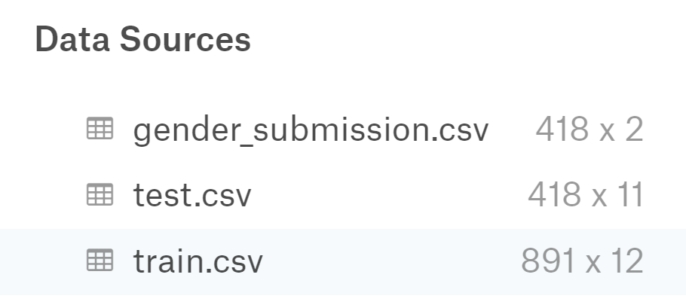
Introduction - Data

Slide 5
Introduction - Data
(#) PassengerId - Unique ID of the passenger
(#) Survived - Survived (1) or died (0)
(#) Pclass - Passenger's class (1st, 2nd, or 3rd)
(A) Name - Passenger's name
(A) Sex - Passenger's sex
(#) Age - Passenger's age
(A) SibSp - Number of siblings/spouses aboard the Titanic
(#) Parch - Number of parents/children aboard the Titanic
(A) Ticket - Ticket number
(#) Fare - Fare paid for ticket
(A) Cabin - Cabin number
(A) Embarked - Where the passenger got on the ship (C - Cherbourg, S - Southampton, Q = Queenstown)

Slide 6
Problem Definition
Goal
Relevance \ Non-Relevance Information
Reliability of the data
The amount of data
The amount of samples

